Slide 1

Summary
Understanding context
The case studies focus on providing insights into sales performance, stock value, and supply chain optimization across various flavours, regions, and clients. The analysis aims to identify key business metrics such as sales, profits, and inventory value to optimize sales and stock management.
Data cleaning and assumption
Provide cleaning steps and some assumptions that might have during the analysis. For this case study, data cleaning was done with M-query. All steps are accessible in shared PBIX file. Home tab > Transform data.
Key Insights and Next steps
Screenshot of dashboard pages, charts and explanations on results.
By Tran Huynh

Slide 2
Data cleaning and assumptions
1. Table Naming Conventions
Original table names followed the format “public tablename”, but these were changed to fit the standard dim and fact table structure for a cleaner data model (e.g., dim Customer, fact Sales).
2. Duplicate Names for Customers and Flavors:
Some customers and flavors have the same names but different IDs, which could cause confusion in the analysis. To resolve this, ID_name columns were created for both dim Customer and dim Flavor tables to differentiate between entries with identical names but different IDs.
3. Missing Ingredient Data
Dim Ingredients has missing data for ingredient IDs under 100, where costs are marked as 0, potentially skewing cost calculations and leading to a significant difference between sales and ingredient costs.
4. Country Normalization:
Both dim Customer and dim Provider tables contained country names in non-standardized formats (e.g., US vs. United States). To resolve this, normalized country columns were created in each table, allowing for a standardized link to the dim Location table based on a consistent Country ID.
5. Currency Assumptions
USD was assumed as the currency based on the amount_dollar column in the Sales Transaction table, as no explicit currency was provided in the case study. In a real scenario, this would need to be clarified.
6. Dim Dates Table
A Dim Dates table was introduced to enhance time-based analysis, enabling filtering by various periods (e.g., year, quarter, month).
7. Dim Region
The Dim Region table was sourced from a Web API to provide regional data.
8. Fiscal/Calendar Year:
For simplicity, the calendar year was used, with a default year-end of December 31st, as no specific fiscal year details were provided.
9. Outdated Recipe Data:
The Current_version flag in the Recipe table was used to filter out outdated recipes from cost calculations.
By Tran Huynh

Slide 3
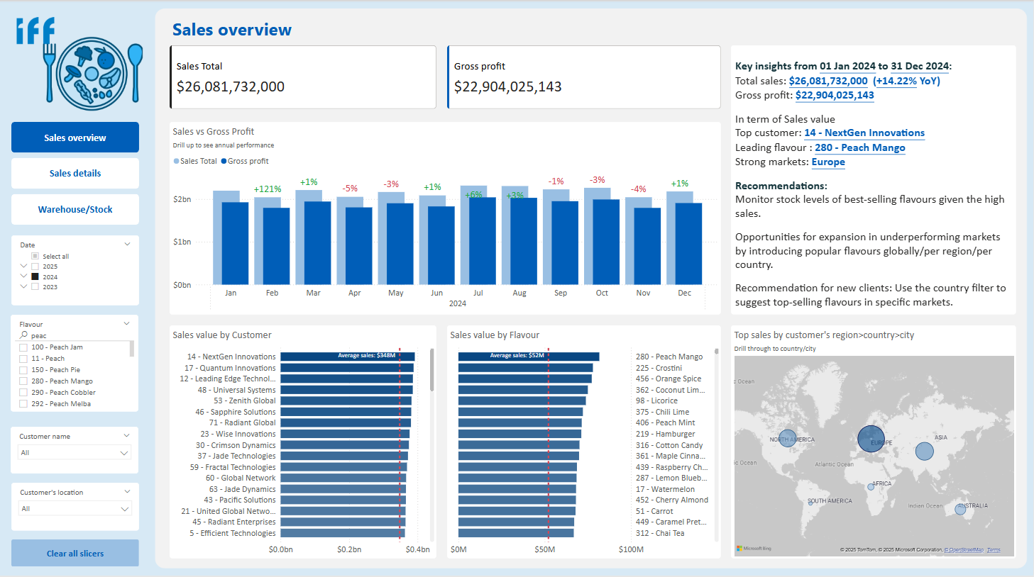
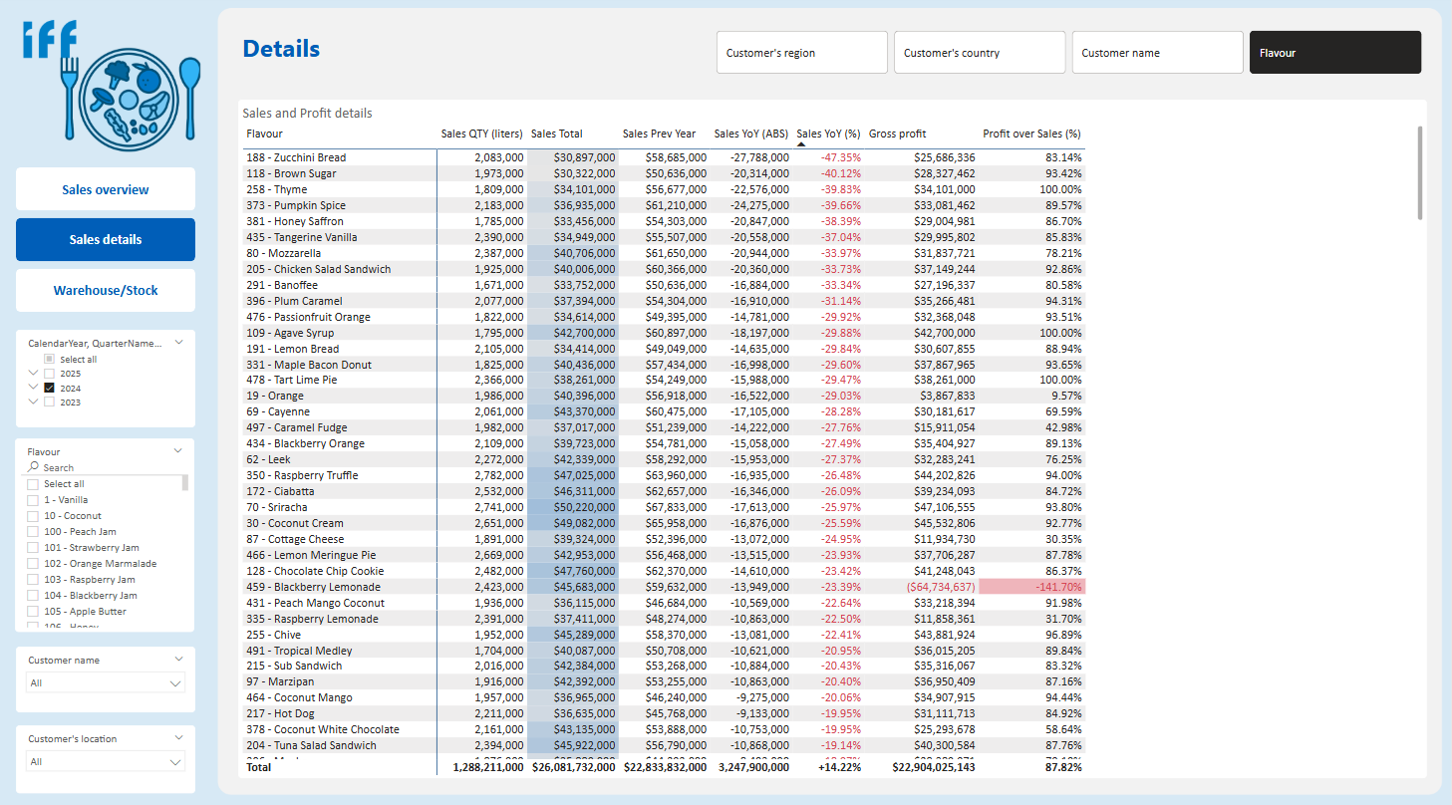
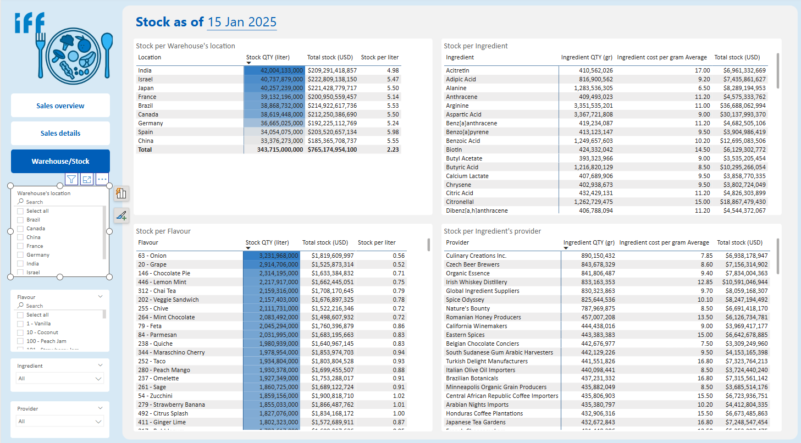
Screenshots of report’s pages
By Tran Huynh

Slide 4
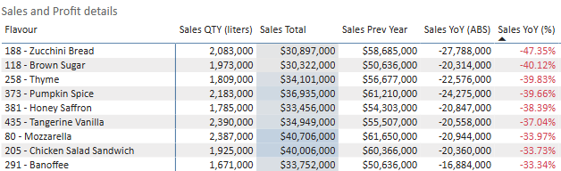
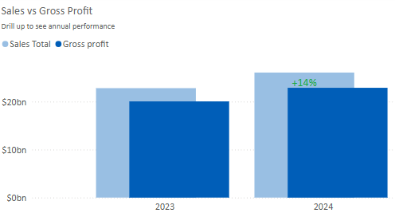
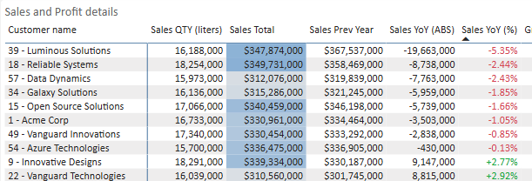
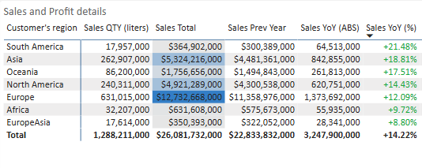
Did we improve sales from one year to the next or did we underperform? For which flavor/client/region?
Sales Improved Globally: Overall sales showed a positive improvement from 2023 to 2024. Assuming the company has a target of 15% growth annually, this performance is closed to the target.
Regional Trends: All regions displayed positive trends. Europe had highest sales values, but YoY growth was about 12%. While South America had a highest growth of more than 20%, implying a growing market.
Flavour Trends: Some showed declines flavours (e.g., Zucchini Bread and Brown Sugar of -47% and -40%.
Customer Trends: Some clients (e.g., Luminous Solutions, Reliable Systems) also showed sales declines, but these were relatively smaller.
Deeper analysis needs to be done to understand the negative trends of those customers/flavours
Key Insights
Suggestions
By Tran Huynh

Slide 5
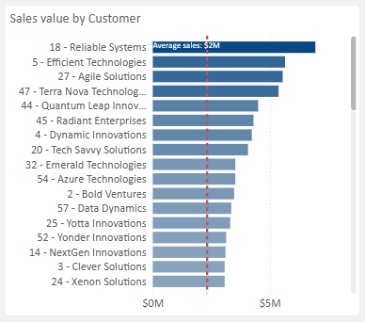
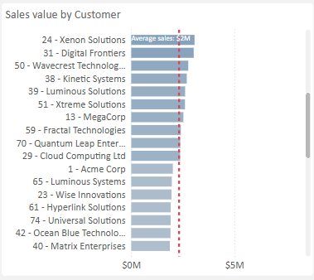
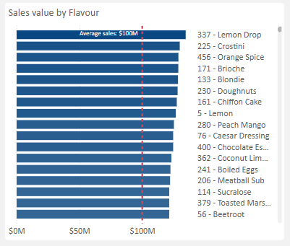
Which clients are top consumers and which clients still have potential (i.e. above or below average) w.r.t. a particular flavour?
To get this information, a flavour should be selected from Flavour slicer on the left.
For example, with regards to 337-Lemon Drop flavour, the top customer is 18-Reliable Systems.
Top 3 clients who still have potential with values closed to the average line on the lower bound are 59-Fractal Technologies, 70-Quantum Leap Entertainment, 29-Cloud Computing. Those clients could present opportunities for growth.
Key Insights
Suggestions
Are there any relations between any 2 flavours in terms of sales (in general/ per client, globally/per country/per region)? In other words, is there a chance that any 2 flavours to be bought together?
Due to the time constraint of me working full-time, this analysis hasn’t been done within the scope of this case study. However, I had a similar correlation analysis and customer segmentation showcased on my website at www.tranhuynh.nl > Market Segmentation (Python) (or via this link)
Bonus: could you help recommend new flavours to any new client based on the previous analysis?
New flavour could be recommended for new customer based on selection of their location.
For instance, based on the most completed data (2024), new clients in Germany are recommended to 110-Maple Syrup flavour.
By Tran Huynh

Slide 6
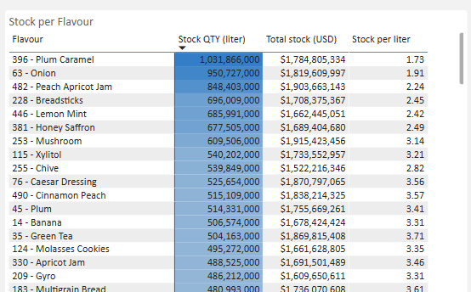
What are the different amounts of flavours and the respective ingredients for a given region/country and how much do they cost at any given period?
As of latest data point in the sample, with selection of Stock’s location in Germany, for example, 396-Plum Caramel, 63-Onion are flavours having the highest stock quantities.
Sales team in Europe should boost sales performance for flavours with high quantities
However, 253-Mushroom, and 76-Caesar Dressing have higher figures in term of values.
Attention should be paid to those flavours in term of storage conditions to avoid being expired, potentially causing high financial loss due to expired products.
Key Insights
Suggestions
Next steps
Implement Flavour Correlation
Implement Sales Forecasting models
Add Stock Value Visualizations and create a more interactive dashboard to monitor supply chain operations
Continue developing Customer Segmentation and product recommendations based on purchasing patterns.
By Tran Huynh

